Slide 1


DIGITAL LOGIC DESIGN
(Course Code: ECE 1003)
Module-1:Lecture-3
Number Systems
Dr. Subhasish Mahapatra
Sr. Assistant Professor
School of Electronics Engineering (SENSE)
VIT-AP University
E-Mail: subhasish.m@vitap.ac.in

Slide 2

CONTENTS
Module-1 (Part-1)
Number systems and conversions
Binary arithmetic operations
r’s and (r-1)’s compliment
Binary signed and unsigned numbers
Weighted and non-weighted binary codes
Dr. Subhasish Mahapatra
Sr. Assistant Professor, SENSE
Number Systems

Slide 3
CONTENTS
Lecture-3
Conversion of different number systems (cont…)
Binary Arithmetic
Dr. Subhasish Mahapatra
Sr. Assistant Professor, SENSE
Number Systems

Slide 4
BOOKS
Textbooks
M.Morris Mano, Michael D Ciletti, Digital Design, 5th edition, Pearson Publishers, 2013.
R.P. Jain, “Modern Digital Electronics”, 4th edition, TMH.
References
M.Morris Mano, Charles R. Kime, Tom Martin, Logic and Computer Design Fundamentals, 4th edition, Pearson Publishers.
C. H. Roth and L. L. Kinney, Fundamentals of Logic Design, 5th edition, Cengage Publishers.
Dr. Subhasish Mahapatra
Sr. Assistant Professor, SENSE
Number Systems

Slide 5
Number Systems
Dr. Subhasish Mahapatra
Sr. Assistant Professor, SENSE
Number Systems

Slide 6
CONVERSION BETWEEN NUMBER BASES
The possibilities:
Decimal
Binary
Octal
Hexadecimal
Dr. Subhasish Mahapatra
Sr. Assistant Professor, SENSE
Number Systems

Slide 7
CONVERSION FROM BINARY TO OCTAL
Decimal
Binary
Octal
Hexadecimal
Dr. Subhasish Mahapatra
Sr. Assistant Professor, SENSE
Number Systems

Slide 8
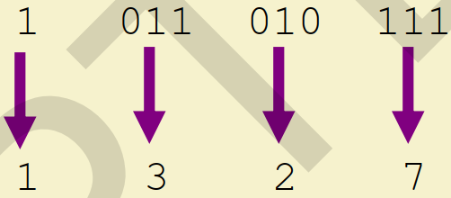
CONVERSION FROM BINARY TO OCTAL
Technique:
Group bits in threes, starting on right for integer part and from left for fractional part.
Ignore leading zeros and add zeros after decimal if necessary, to form group of three bits.
Convert to octal digits
Example: (1011010111)₂ = (N)₈
(1011010111)₂ = (1327)₈
Dr. Subhasish Mahapatra
Sr. Assistant Professor, SENSE
Number Systems

Slide 9
CONVERSION FROM BINARY TO OCTAL
Example: (1010111000.0101)₂ = (N)₈
1 010 111 000 . 010 100
1 2 7 0 . 2 4
(1010111000.0101)₂ = (1270.24)₈
Dr. Subhasish Mahapatra
Sr. Assistant Professor, SENSE
Number Systems

Slide 10
CONVERSION FROM BINARY TO HEXADECIMAL
Decimal
Binary
Octal
Hexadecimal
Dr. Subhasish Mahapatra
Sr. Assistant Professor, SENSE
Number Systems

Slide 11
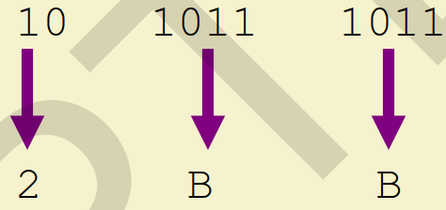
CONVERSION FROM BINARY TO HEXADECIMAL
Technique:
Group bits in fours, starting on right for integer part and from left for fractional part.
Ignore leading zeros and add zeros after decimal if necessary, to form group of four bits.
Convert to hexadecimal digits
Example: (1010111011)₂ = (N)₁₆
(1010111011)₂ = (2BB)₁₆
Dr. Subhasish Mahapatra
Sr. Assistant Professor, SENSE
Number Systems

Slide 12
CONVERSION FROM BINARY TO OCTAL
Example: (1010111000.0101)₂ = (N)₁₆
0010 1011 1000 . 0101
2 B 8 . 5
(1010111000.0101)₂ = (2B8.5)₁₆
Dr. Subhasish Mahapatra
Sr. Assistant Professor, SENSE
Number Systems

Slide 13
CONVERSION FROM OCTAL TO BINARY
Decimal
Binary
Octal
Hexadecimal
Dr. Subhasish Mahapatra
Sr. Assistant Professor, SENSE
Number Systems

Slide 14
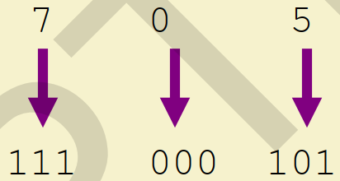
CONVERSION FROM OCTAL TO BINARY
Technique:
Convert each octal digit to a 3-bit equivalent binary representation
Example: (705)₈ = (N)₂
(705)₈ = (111000101)₂
Dr. Subhasish Mahapatra
Sr. Assistant Professor, SENSE
Number Systems

Slide 15
CONVERSION FROM OCTAL TO BINARY
Example: (1472.16)₈ = (N)₂
1 4 7 2 . 1 6
1 100 111 010 . 001 110
(1472.16)₈ = (1100111010.00111)₂
Dr. Subhasish Mahapatra
Sr. Assistant Professor, SENSE
Number Systems

Slide 16
CONVERSION FROM OCTAL TO HEXADECIMAL
Decimal
Binary
Octal
Hexadecimal
Dr. Subhasish Mahapatra
Sr. Assistant Professor, SENSE
Number Systems

Slide 17
CONVERSION FROM OCTAL TO HEXADECIMAL
Technique:
Use binary as an intermediary
Example: (1472.16)₈ = (N)₁₆
1 4 7 2 . 1 6
1 100 111 010 . 001 110
(1472.16)₈ = (33A.38)₁₆
001 100 111 010 . 001 11000
3 3 A . 3 8
Dr. Subhasish Mahapatra
Sr. Assistant Professor, SENSE
Number Systems

Slide 18
CONVERSION FROM HEXADECIMAL TO BINARY
Decimal
Binary
Octal
Hexadecimal
Dr. Subhasish Mahapatra
Sr. Assistant Professor, SENSE
Number Systems

Slide 19
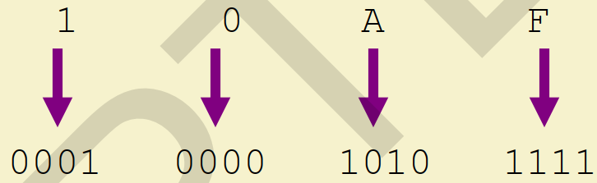
CONVERSION FROM HEXADECIMAL TO BINARY
Technique:
Convert each hexadecimal digit to a 4-bit equivalent binary representation
Example: (10AF)₁₆ = (N)₂
(10AF)₁₆ = (1000010101111)₂
Dr. Subhasish Mahapatra
Sr. Assistant Professor, SENSE
Number Systems

Slide 20
CONVERSION FROM HEXADECIMAL TO BINARY
Example: (A5BF.0C)₁₆ = (N)₂
A 5 B F . 0 C
1010 0101 1011 1111 . 0000 1100
(A5BF.0C)₁₆ = (1010010110111111.000011)₂
Dr. Subhasish Mahapatra
Sr. Assistant Professor, SENSE
Number Systems

Slide 21
CONVERSION FROM HEXADECIMAL TO OCTAL
Decimal
Binary
Octal
Hexadecimal
Dr. Subhasish Mahapatra
Sr. Assistant Professor, SENSE
Number Systems

Slide 22
CONVERSION FROM HEXADECIMAL TO OCTAL
Technique:
Use binary as an intermediary
Example: (A5BF.0C)₁₆ = (N)₈
A 5 B F . 0 C
1010 0101 1011 1111 . 0000 1100
(A5BF.0C)₁₆ = (122677.03)₈
001010 0101 1011 1111 . 0000 1100
1 2 2 6 7 7 . 0 3
Dr. Subhasish Mahapatra
Sr. Assistant Professor, SENSE
Number Systems

Slide 23
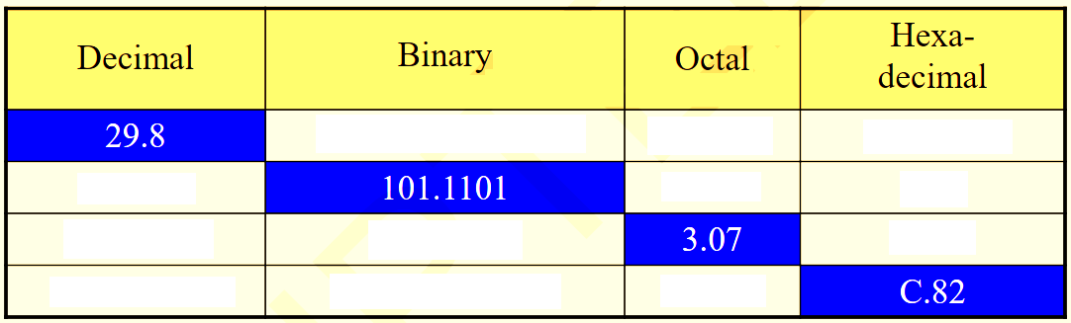
ASSIGNMENT QUESTION
Fill the table:
Dr. Subhasish Mahapatra
Sr. Assistant Professor, SENSE
Number Systems

Slide 24
Binary Arithmetic
Dr. Subhasish Mahapatra
Sr. Assistant Professor, SENSE
Number Systems

Slide 25
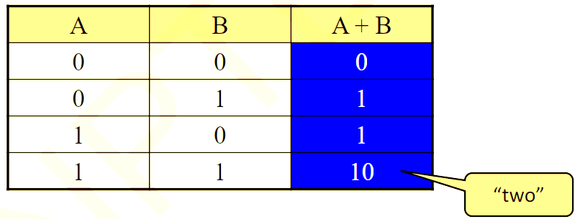
BINARY ADDITION
Two 1-bit values:
Dr. Subhasish Mahapatra
Sr. Assistant Professor, SENSE
Number Systems

Slide 26
BINARY ADDITION
Two n-bit values:
Add individual bits
Propagate carries
Example:
1
1
1
1
1
1
carries
1 1 1 1 0 1
+ 1 0 1 1 1
---------------------
6 1
+ 2 3
----------
1
0
1
0
1
0
0
8
4
Dr. Subhasish Mahapatra
Sr. Assistant Professor, SENSE
Number Systems

Slide 27
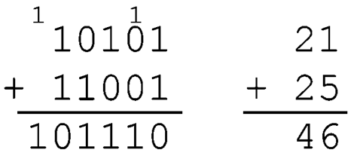
BINARY ADDITION
Two n-bit values:
Add individual bits
Propagate carries
Example:
Dr. Subhasish Mahapatra
Sr. Assistant Professor, SENSE
Number Systems

Slide 28
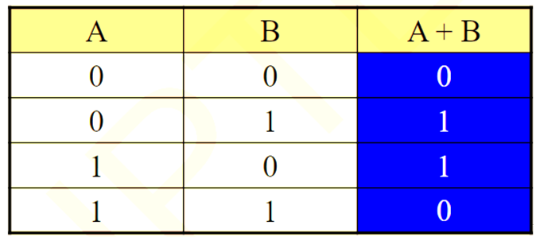
BINARY SUBTRACTION
Two 1-bit values:
With Borrow 1
Dr. Subhasish Mahapatra
Sr. Assistant Professor, SENSE
Number Systems

Slide 29
BINARY SUBTRACTION
Two n-bit values:
Subtract individual bits with borrow if necessary
Example:
10- decimal value 2
10
0
0
10
Borrows
1 1 1 1 0 1
+ 1 0 1 1 1
---------------------
6 1
- 2 3
----------
1
0
0
1
1
0
3
8
Dr. Subhasish Mahapatra
Sr. Assistant Professor, SENSE
Number Systems

Slide 30
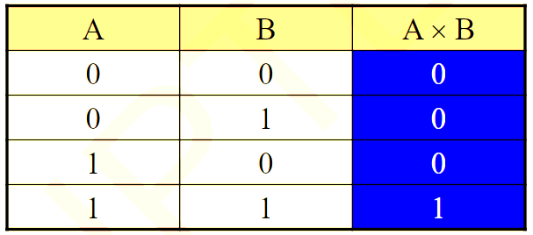
BINARY MULTIPLICATION
Two 1-bit values:
Dr. Subhasish Mahapatra
Sr. Assistant Professor, SENSE
Number Systems

Slide 31
BINARY MULTIPLICATION
Example:
1 0 1 1 1
X 1 0 1 0
-----------------------
0 0 0 0 0
1 0 1 1 1
0 0 0 0 0
1 0 1 1 1
-----------------------
1 1 1 0 0 1 1 0
2 3
X 1 0
----------
2
3
0
Dr. Subhasish Mahapatra
Sr. Assistant Professor, SENSE
Number Systems

Slide 32
ASSIGNMENT QUESTIONS
Add: (1000111)₂ + (1110)₂
Subtract: (1110000)₂ – (1111)₂
Multiply: (101)₂ x (10101)₂
Dr. Subhasish Mahapatra
Sr. Assistant Professor, SENSE
Number Systems

Slide 33

Please follow the instructions of the government and stay safe
Dr. Subhasish Mahapatra
Sr. Assistant Professor, SENSE
Number Systems

